Slide 1
Final Project – Forecasting Dengue Spread
Time Series Analysis & Forecasting: MSCA 31006
June, 2019
Team Members:
Siddhartha Khetawat
Srihari Seshadri

Slide 2



Introduction
Analyzing historical Dengue cases in San Juan, Puerto Rico to make weekly forecasts that will help the city be better prepared in the event of fatal epidemics
Using environmental data collected by Centers for Disease Control & Prevention and the National Oceanic & Atmospheric Administration in the U.S. Department of Commerce
Explored various forecasting models that account for components such as Trend and Seasonality and also external variables describing changes in temperature, precipitation, humidity, etc.

Slide 3
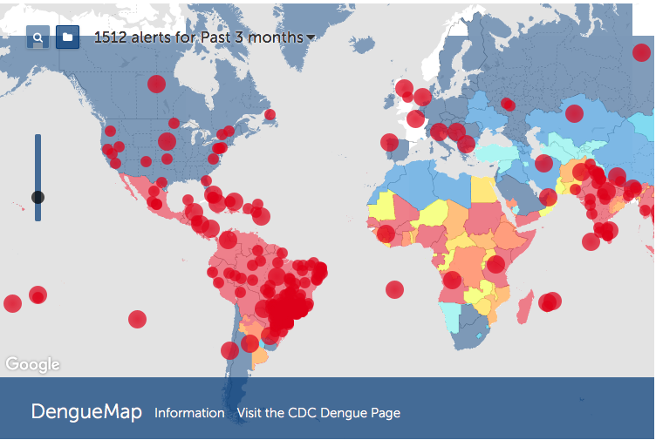
Problem Statement
Dengue fever is a mosquito-borne disease that occurs in tropical and sub-tropical parts of the world that can cause bleeding, low blood pressure, and even death in severe cases
Because it is carried by mosquitoes, the transmission dynamics of dengue are related to climate variables such as temperature and precipitation
In recent years, dengue fever has been spreading. Historically, the disease has been most prevalent in Southeast Asia and the Pacific islands. These days many of the nearly half billion cases per year are occurring in Latin America

Slide 4
Data
Original Data
Train:
1990 - 2002
Test:
2003 - 2008

Slide 5
Data Imputation
Used LOCF (Last Observation Carried Forward) to impute these missing observations in the data
Example of missing data

Slide 6
Assumptions – Stationarity
ADF Test:
KPSS Test:

Slide 7
Assumptions – ACF / PACF

Slide 8
Data Properties – Seasonality / Trend
Observations:
We break down the “number of cases” time series into Seasonality, Trend and Remainder
Looking at the Seasonality plot, we can clearly see a seasonal pattern with peaks observed every year around summer time
We can observe some levels in the Trend plot, with both positive and negative trend occurring over the years

Slide 9
Exploratory Data Analysis
Histogram
Correlations

Slide 10
Exploratory Data Analysis

Slide 11
Model 1 – ARIMA
Model Summary:
Residual Analysis:
ACF Test:

Slide 12
Model 2 – SARIMA
Model Summary:
Residual Analysis:
ACF Test:

Slide 13
Model 3 – SARIMAX
Model Summary:
Residual Analysis:
ACF Test:

Slide 14
Model 4 – Neural Net
Model Summary:
Residual Analysis:
ACF Test:

Slide 15
ARIMA Forecasts
SARIMA Forecasts

Slide 16
SARIMAX Forecasts
Neural Net Forecasts

Slide 17
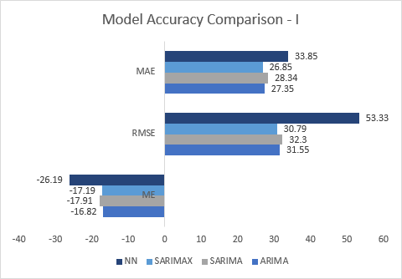
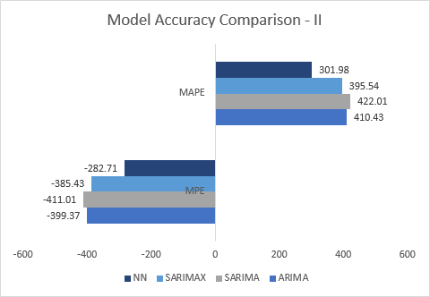
Model Selection

Slide 18
Conclusion and Next Steps
Conclusion:
Dengue fever cases have a seasonal pattern that can be modeled using various forecasting techniques
We forecasted the test data using 4 models with increasing complexity using external variables
SARIMAX and Neural Nets performed better on certain evaluation metrics because these models were able to accommodate environmental factors such as temperature, humidity and precipitation
SARIMAX was able to capture the seasonality well, without being impacted by the anomalous data points
The forecasts from Neural Nets was also pretty good but it got impacted by the anomalies in the data
Next Steps:
Try some data transformations such as Box-Cox, Fourier transforms, etc. to better capture effects of predictors
Develop an anomaly detection model to identify the outliers in the data which will help us improve the model
Explore some other forecasting techniques such as Regression with ARMA errors and TBATS in case there is multiple seasonality in the data
Explore deep learning models such as MPL, RNN and LSTM to get better forecasts

